Slide 1
New Senator Orientation

Slide 2
What is parliamentary procedure?
A set of rules used to govern a meeting
Focuses on
Equality
Efficiency

Slide 3
Parli Pro in SGA
Traditional format used every week
Something to say?
Stand placard on end
Wait to be recognized
Say, “Thank you, Mr. Speaker.”
Ask question or make statement!

Slide 4
Discussion and Debate
Discussion is used to ask questions about a bill or resolution.
Example: Where will the money come from?
Debate is used to bring attention to the pros or cons of a bill, resolution, motion, etc.
MUST be only about what is being debated!
GOOD: This resolution is not relevant to the students of MSU.
BAD: It would be better if we did a resolution about XYZ instead.

Slide 5
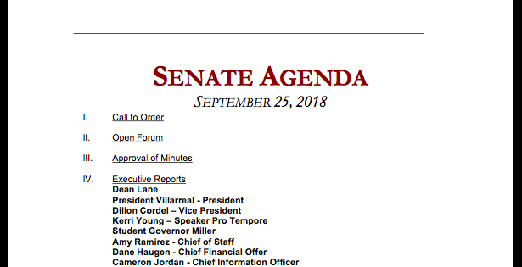
Beginning of Senate
I. Gavel is rapped, meeting begins.
II. Outside speakers, feel free to ask questions at the end
III. If you found errors in last week’s minutes, raise your placard and point it out!
IV. Sit back and listen to reports

Slide 6
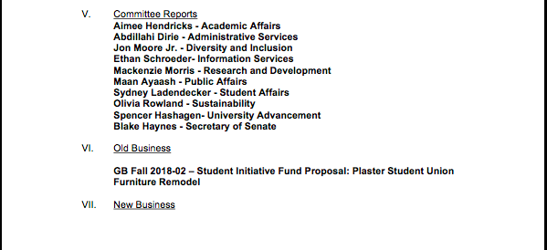
Middle of Senate
V. More Reports
VI. Things started last week are continued here.
VII. Things are introduced here. Agenda items come first, then anything else senators have to introduce.

Slide 7
End of Senate
VIII. If you have an announcement about your org, raise your placard.
IX. Speaker asks for motion to adjourn, hold up your placard if you want to.

Slide 8
General Bills
Campus-wide business
Week 1:
Introduced and read
Discussion (ask questions!)
Week 2:
Further Discussion
Debate
Vote

Slide 9
Senate Bills
Senate-wide business
Week 1:
Introduced and read
Discussion (ask questions!)
Debate
Vote

Slide 10
Questions
Feel free to ask me or your committee chair if you have any other questions!

